Slide 1
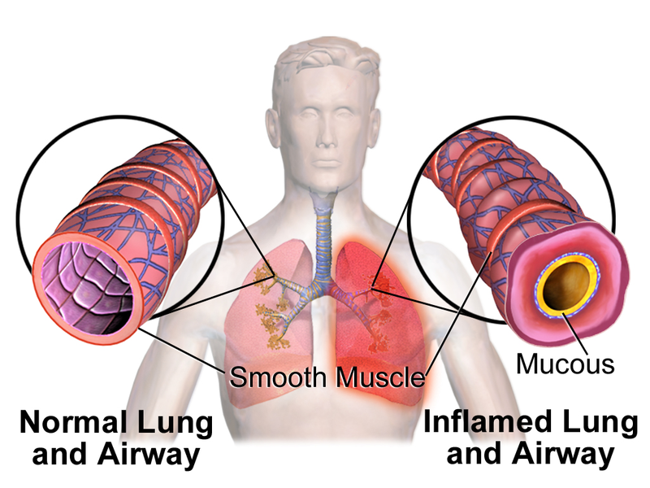
Allergic Asthma
Asthma that is triggered by allergens, substances that your immune system thinks are harmful
Triggers inflammation, causing the airways to swell and narrow, obstructs breathing
In severe cases, patients may not respond to common treatments
Severity is affected by the response of certain immune cells and their signaling molecules

Slide 2
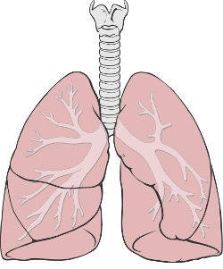
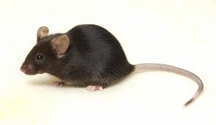
Mouse Experiments
Apply various treatments to asthmatic mice
Measure airway hyperresponsiveness and harvest tissues
Process lungs and airway immune cells
Analysis

Slide 3
My Experience
Learned laboratory skills; pipetting, PCR, etc.
The importance of understanding the concepts behind various processes and experiments
Research requires patience and time
Communication, working with other lab members
Learning by observation
Gaining confidence to be independent and make mistakes

Slide 4
In the Future…
Continue to work in research
SURF summer 2018
RaMP extension fall 2018

