Slide 1
Paternal exposure to house dust mite allergen mitigates the development of house dust mite-induced asthma in offspring
Lindsay Bischoff
Lewkowich Lab
Cincinnati Children’s Hospital Medical Center, Cincinnati, OH.
Poster #12

Slide 2
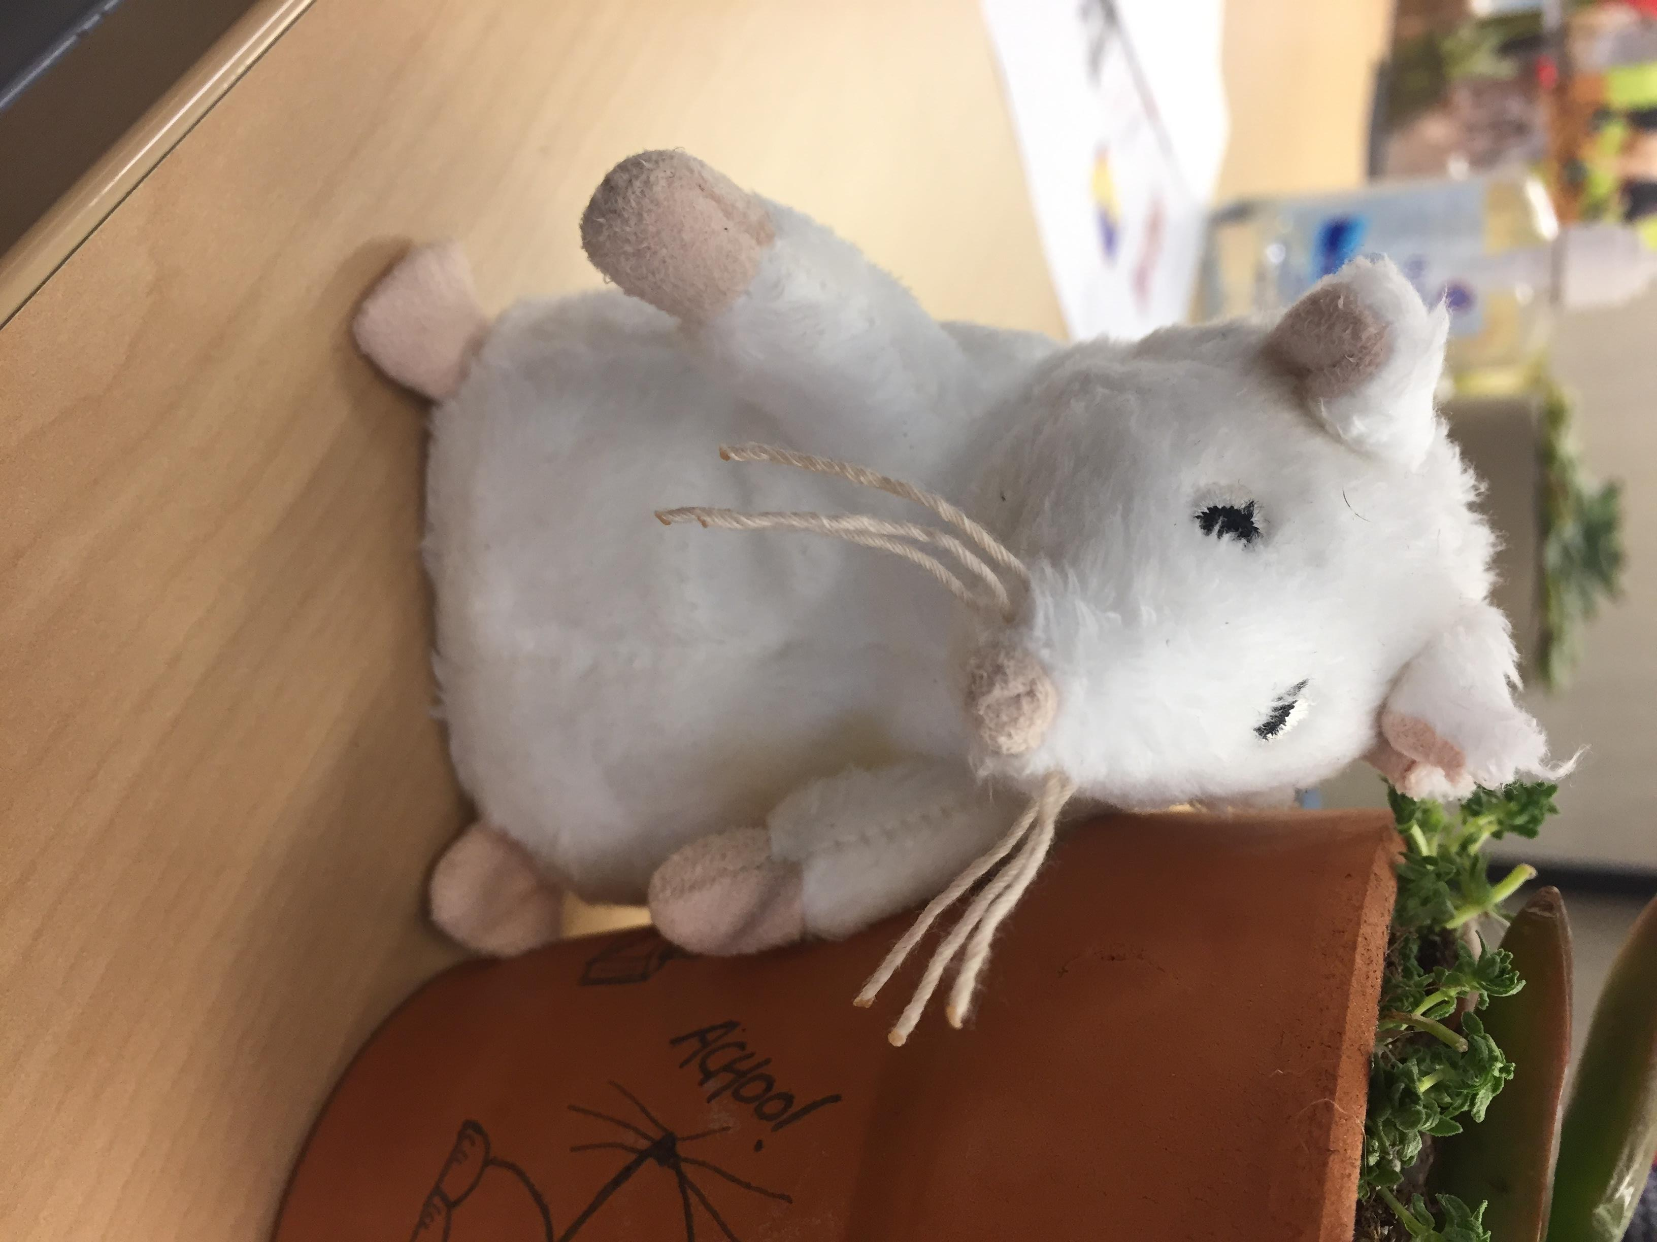
Introduction
Worldwide, over 300 million people are affected by allergic asthma
One of the most common chronic disorders in children
Is increasing at rates too rapidly to be consistent with a purely genetic basis
Growing evidence that early life environmental factors have a greater influence on development
House dust mite (HDM) is a common driver of allergic asthma and 50-80% of asthmatics show a HDM-specific response
HDM exposure also exhibits a dose-response relationship with asthma development

Slide 3

Introduction
B cell
Th2 effector
IL-4
Naïve T cell
Allergen specific IgE
IL-4
IL-5
IL-13
Goblet cell hyperplasia
Bronchial
hyperreactivity
Eos/Mast cells
Eosinophilia
Smooth muscle hypertrophy

Slide 4
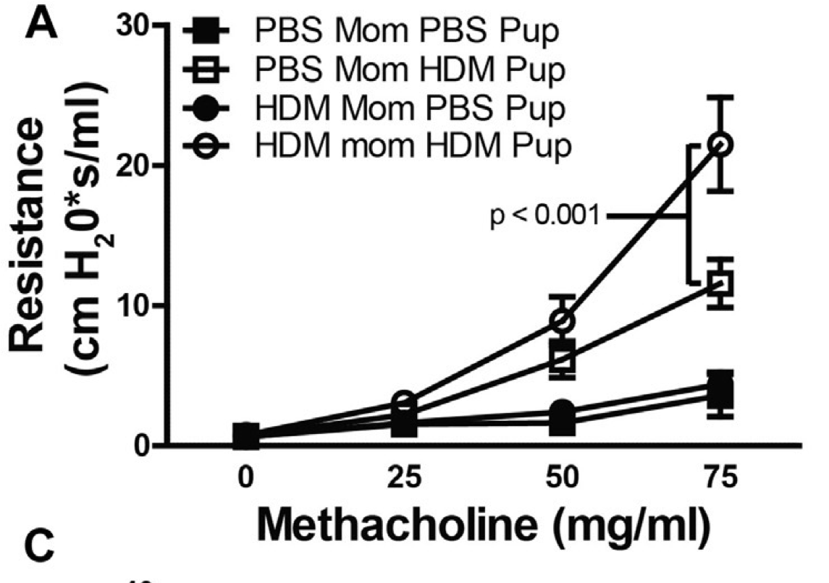
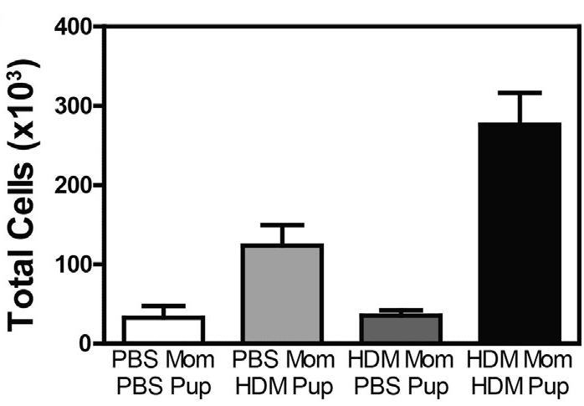
Background
Data from our lab showed that maternal exposure to HDM during pregnancy worsens the development of asthma in offspring
Maternal exposure causes more severe airway hyperresponsiveness, airway inflammation, and increased Th2 cytokine production (Hall S. J Allergy Clin Immunol, 2017)
Measurements of airway
hyperresponsiveness
Total immune cells in the lungs
from bronchoalveolar lavage

Slide 5


Background
The study of maternal exposure contributes to evidence that prenatal environmental exposures can influence asthma development in offspring
Additional studies suggest that paternal exposures (such as pre-conceptual smoking, specific occupations, etc) can also have effects on offspring asthma
While our previous data modeled maternal exposure, the present study explores the effects of paternal HDM exposure on offspring asthma
PBS mom
HDM mom
HDM dad
We hypothesized that paternal allergen exposure would have a similar effect as maternal exposure, and would increase asthma development in offspring
?
Pups exposed to HDM
Pups exposed to HDM

Slide 6
Methods
HDM Father
Male mice were injected with HDM or PBS (control) for 6 ½ weeks to ensure exposure during their entire cycle of spermatogenesis
After mating, offspring sensitized and challenged with HDM or PBS to induce an asthma response
Several asthma endpoints were measured in the mice at harvest: airway inflammation, cytokine levels, gene expression, etc
HDM
PBS
PBS Father
HDM
PBS

Slide 7
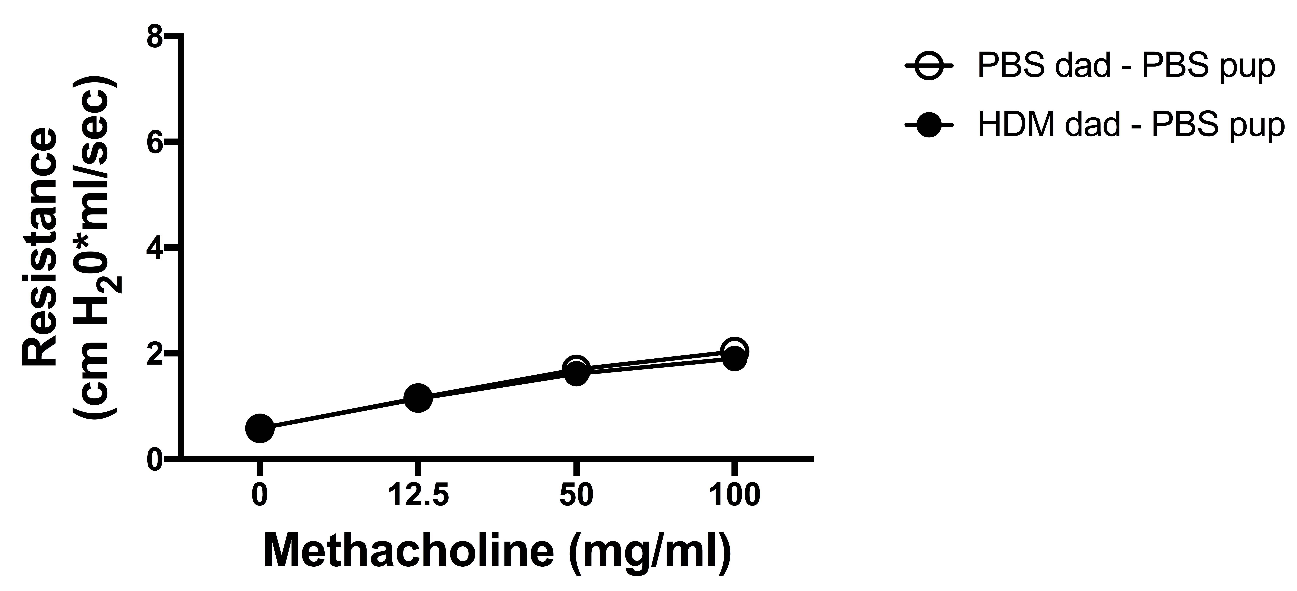
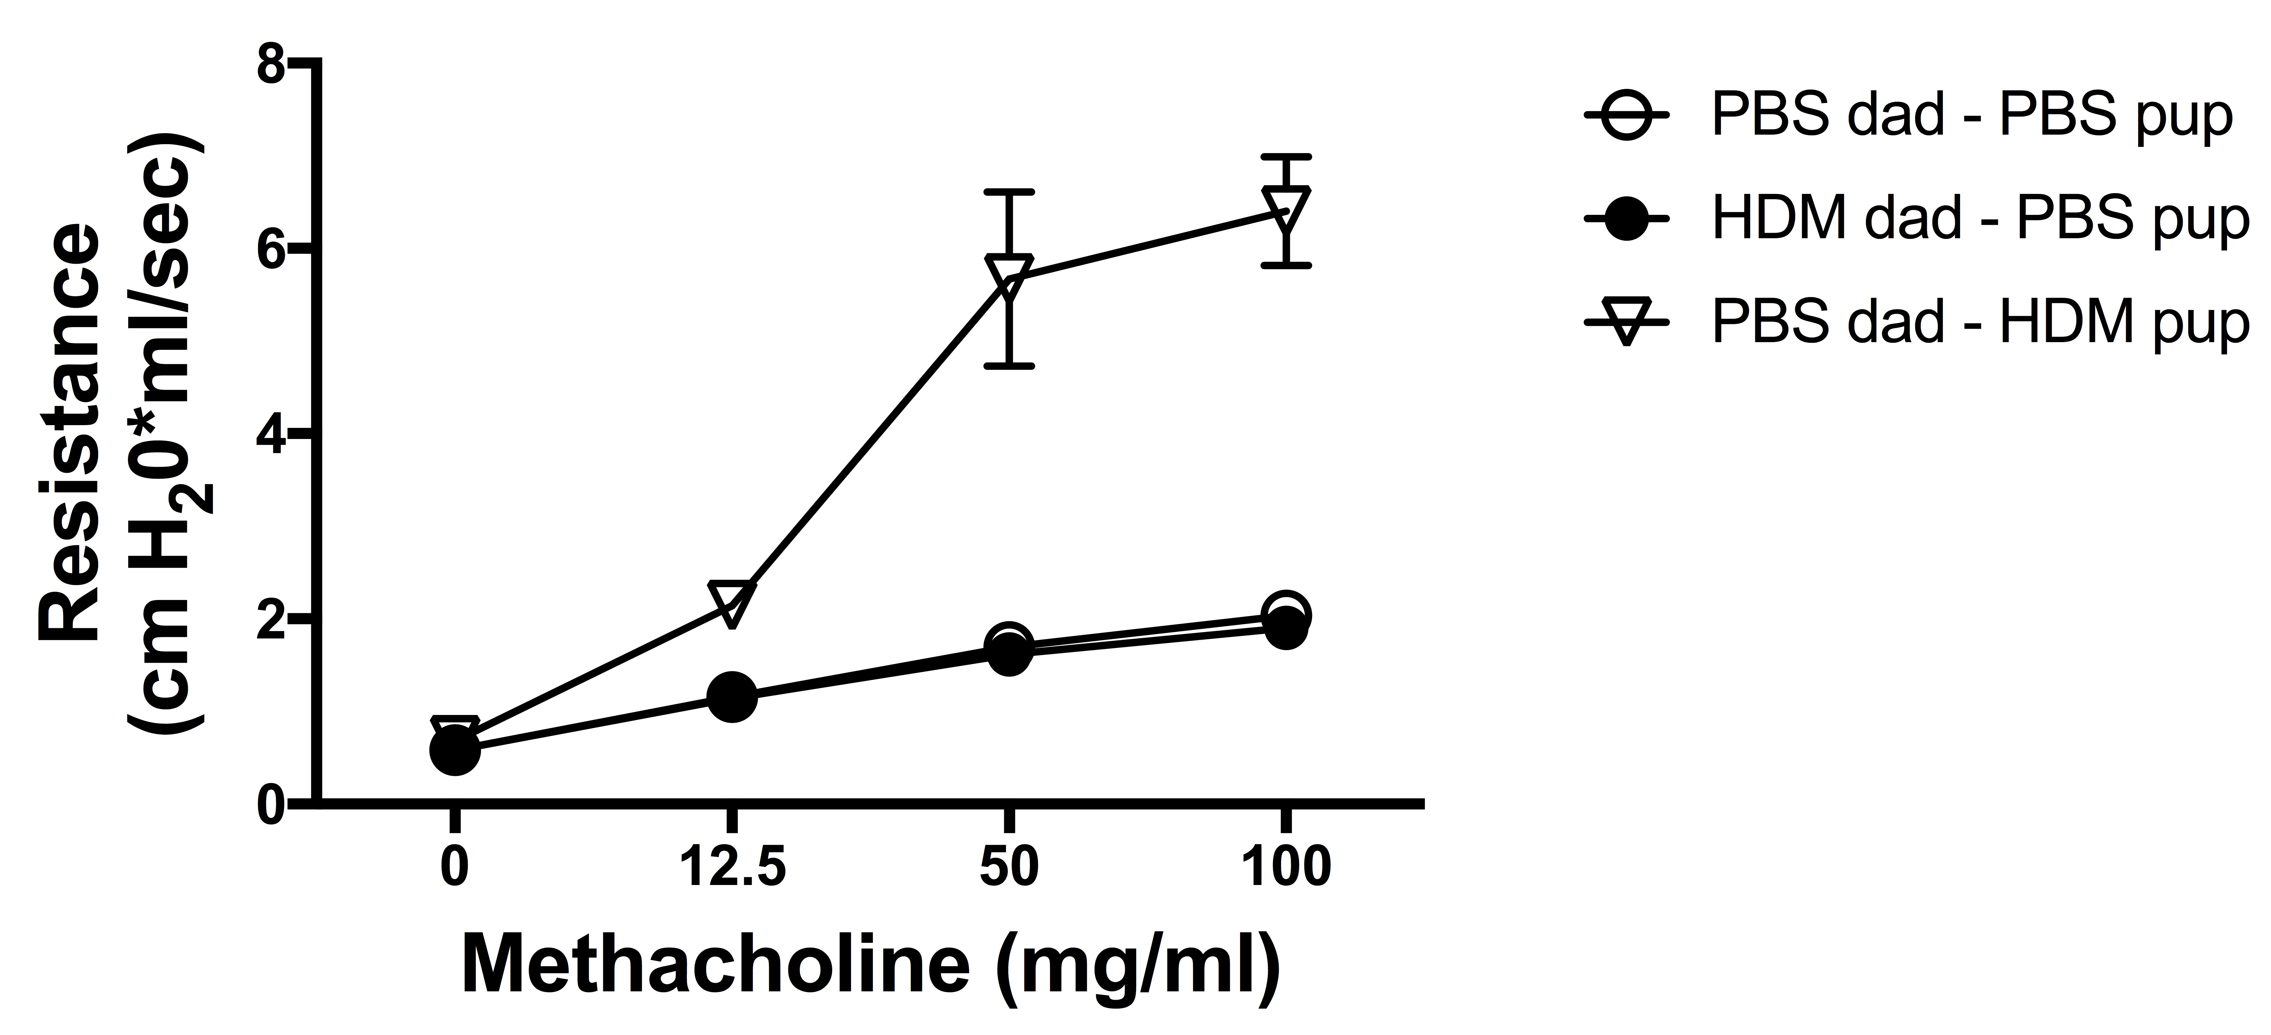
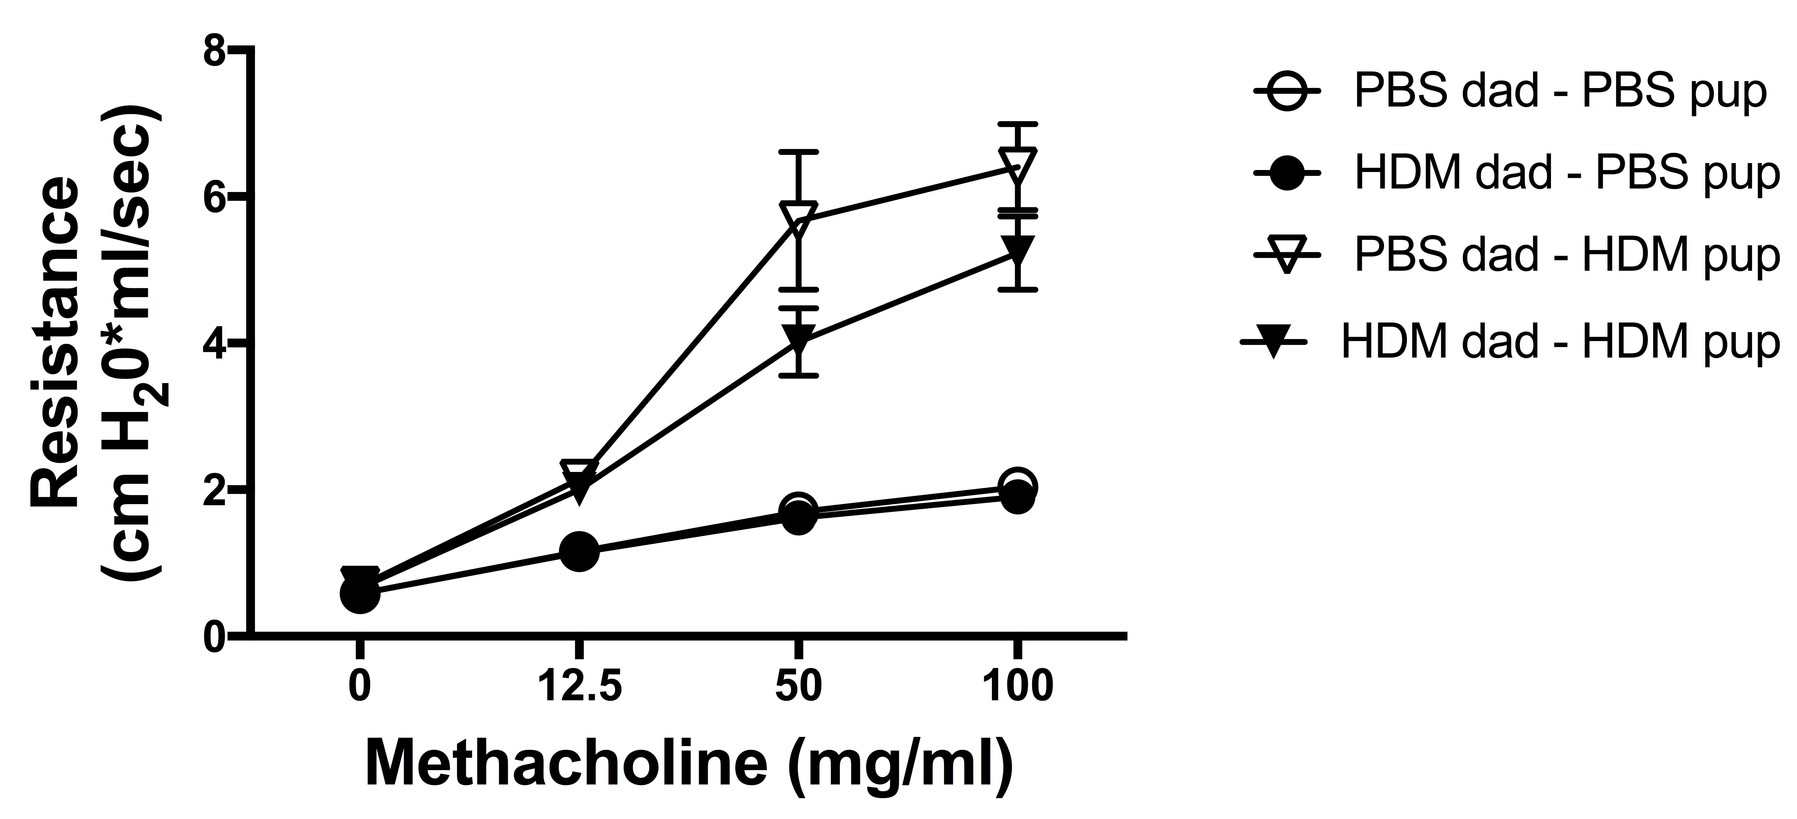
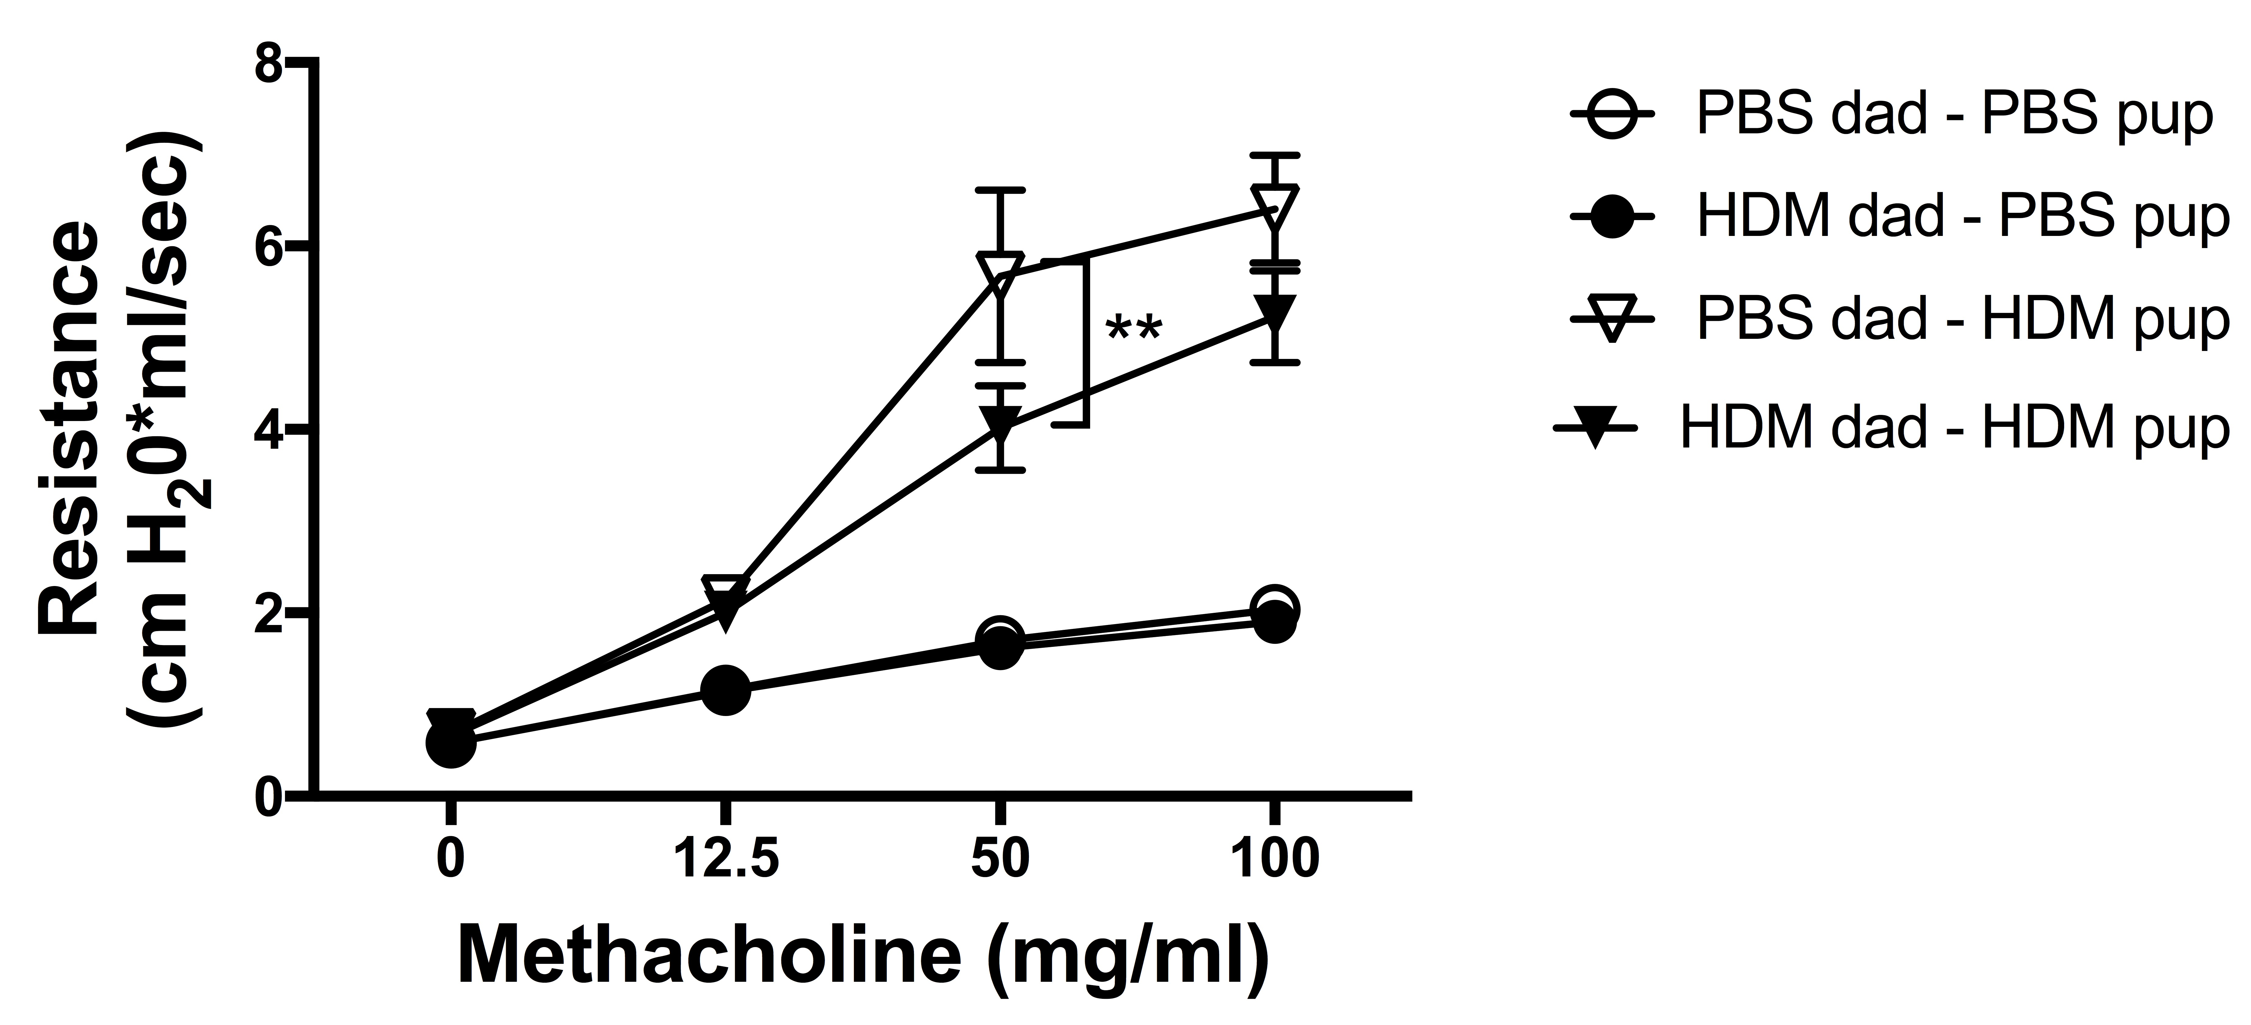
Results
The data are presented as mean peak of resistance ± SEM and represent 14-16 mice per treatment group. **p ≤ .01.
Airway hyperresponsiveness was measured upon harvest
HDM-exposed offspring of HDM-exposed fathers had reduced airway hyperresponsiveness compared to HDM-exposed offspring of PBS fathers

